Slide 1

WEEK
2
Cesar A. Pascal

Slide 2
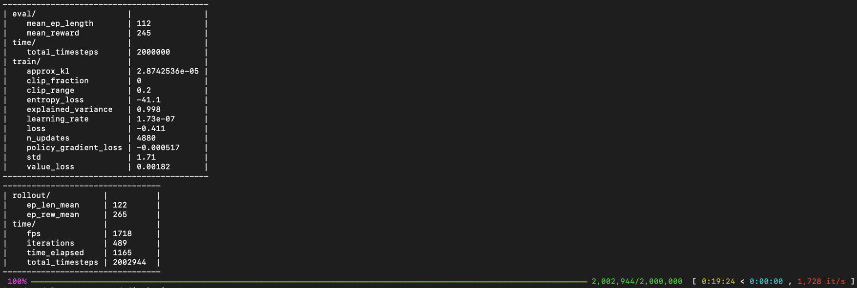
This week, my main objective was to refine the training pipeline to obtain a lower loss and more stable standing behavior. While I managed to reduce the loss compared to previous runs, the learned policy still does not maintain a stable standing posture over time. In parallel, I enhanced the rendering/visualization configuration, enabling greater flexibility in camera control and overall inspection of the simulation in the viewer.

Slide 3
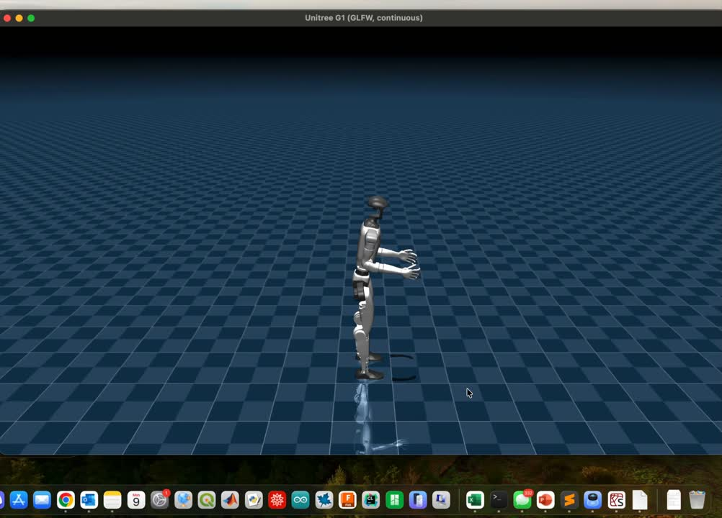
As mentioned previously, the training results were not sufficient. After further analysis, I identified that the main issue was related to the environment definition for the G1 model. The generated environment did not include all the necessary joint properties, such as accurate dynamics and control parameters. A more detailed and complete specification of the joint characteristics was required to achieve stable and reliable training outcomes.

Slide 4
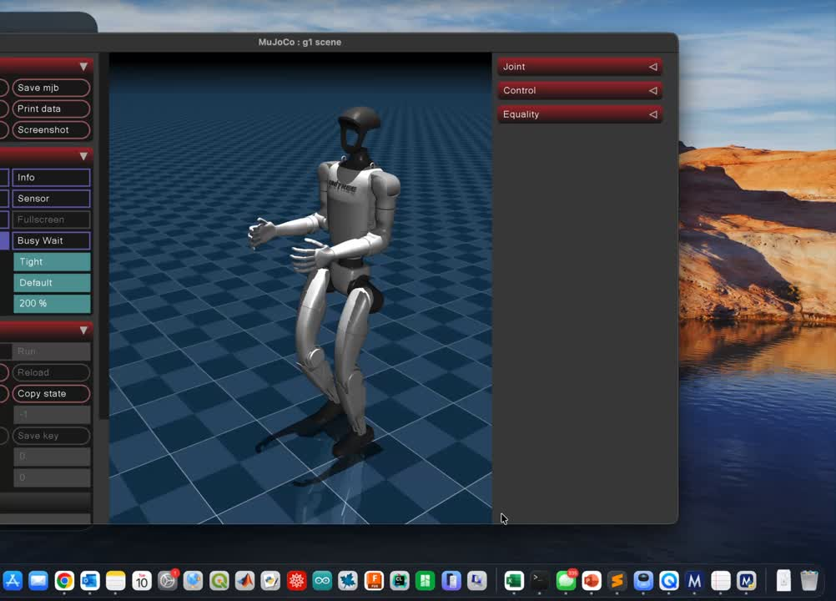
I then adopted a different approach and searched for existing working examples to better understand the overall implementation process. Through this exploration, I was able to obtain a functional walking example of the G1 model and successfully run it on my computer. This allowed me to analyze a stable reference implementation and gain deeper insight into how the training pipeline, environment configuration, and control structure should be properly integrated.

Slide 5
After analyzing the walking model, I developed the idea of extracting joint data at different time steps in order to use it as training samples for a potential machine learning approach. By recording joint positions, velocities, and possibly torques over time, I aim to construct a dataset that captures stable and coordinated motion patterns. This data-driven approach could serve either as supervised training input or as a reference trajectory to guide future reinforcement learning experiments.

Slide 6
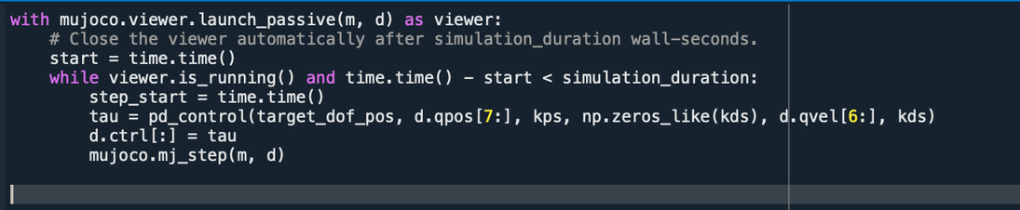
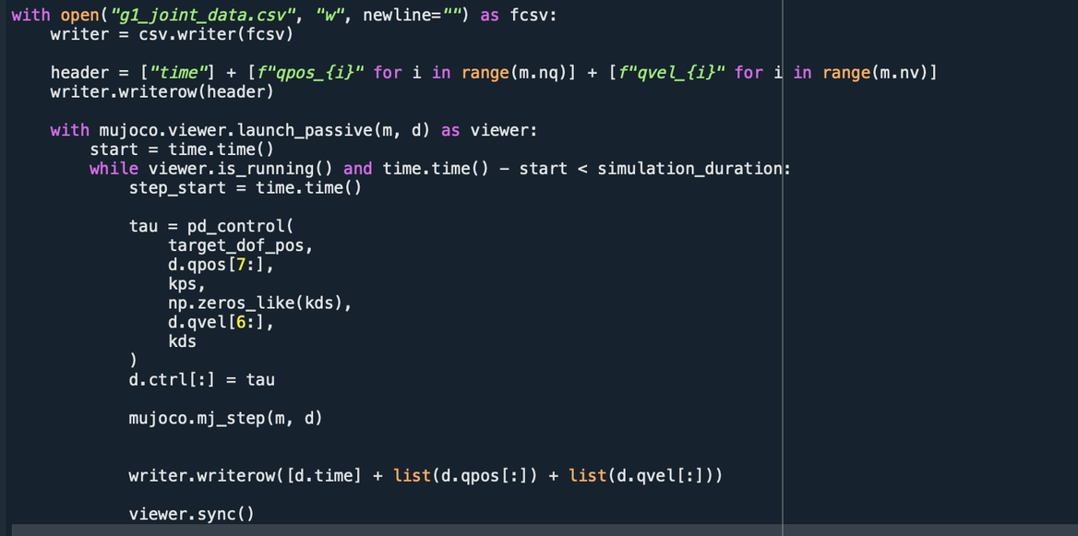
To support this approach, I modified the existing code to record the relevant joint values into a CSV file, including timestamps to ensure accurate and structured data logging. This was achieved by adjusting the viewer configuration, transitioning from a purely passive visualization mode to a setup that also allows data collection during simulation. As a result, I was able to systematically gather joint state information from the working walking model for further analysis and potential use in a machine learning framework.

Slide 7
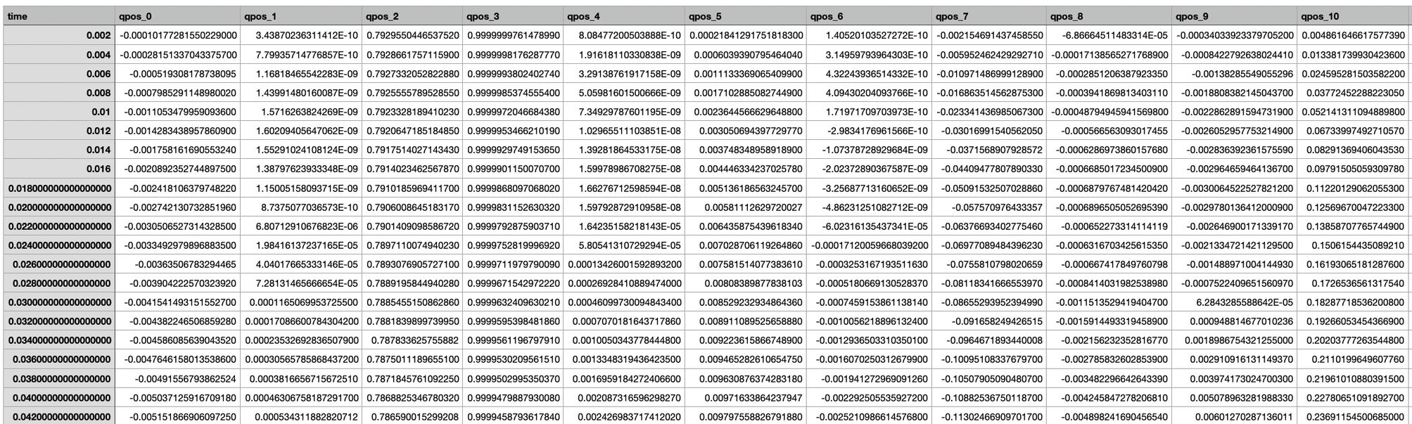
The implementation was successful, and I was able to generate a complete dataset containing all joint values recorded frame by frame. This resulted in a structured data sheet capturing the temporal evolution of the robot’s motion, which can now be analyzed and potentially used for supervised learning, trajectory imitation, or further refinement of the control strategy.

Slide 8
Next steps:
  Create my own implementation inspired by the working model.
  Develop a script to use the collected dataset as input for a machine learning pipeline.
  Build a step-by-step procedure/documentation for generating and validating a working model (from environment setup to deployment).
  Explore additional humanoid robot functionalities (e.g., different gaits, turning, balance recovery, and command tracking).

Slide 9
References
Paszke, A., Gross, S., Massa, F., Lerer, A., Bradbury, J., Chanan, G., et al. (2019). PyTorch: An imperative style, high-performance deep learning library. Advances in Neural Information Processing Systems (NeurIPS). https://pytorch.org
Raffin, A., Hill, A., Gleave, A., Kanervisto, A., Ernestus, M., & Dormann, N. (2021). Stable-Baselines3: Reliable reinforcement learning implementations. https://github.com/DLR-RM/stable-baselines3
Rudin, N., Hoeller, D., Reist, P., & Hutter, M. (2022). Learning to walk in minutes using massively parallel deep reinforcement learning. https://github.com/leggedrobotics/legged_gym
Schulman, J., Wolski, F., Dhariwal, P., Radford, A., & Klimov, O. (2017). Proximal policy optimization algorithms. arXiv preprint arXiv:1707.06347. https://arxiv.org/abs/1707.06347
Todorov, E., Erez, T., & Tassa, Y. (2012). MuJoCo: A physics engine for model-based control. IEEE/RSJ International Conference on Intelligent Robots and Systems (IROS). https://mujoco.org
Unitree Robotics. (n.d.). Unitree G1 humanoid robot. https://www.unitree.com
YAML. (n.d.). YAML Ain’t Markup Language (YAML™) version 1.2.

